Slide 1
Networking Concepts
Corporate Computer Security, 4th Edition
Randall J. Boyle & Raymond R. Panko
Module A

Slide 2
Orientation
This is a module that some teachers will cover while others will not
This module is a refresher on networking concepts, which are important in information security
If your teacher does not cover networking, you might want to cover it yourself to refresh your networking knowledge

Slide 3
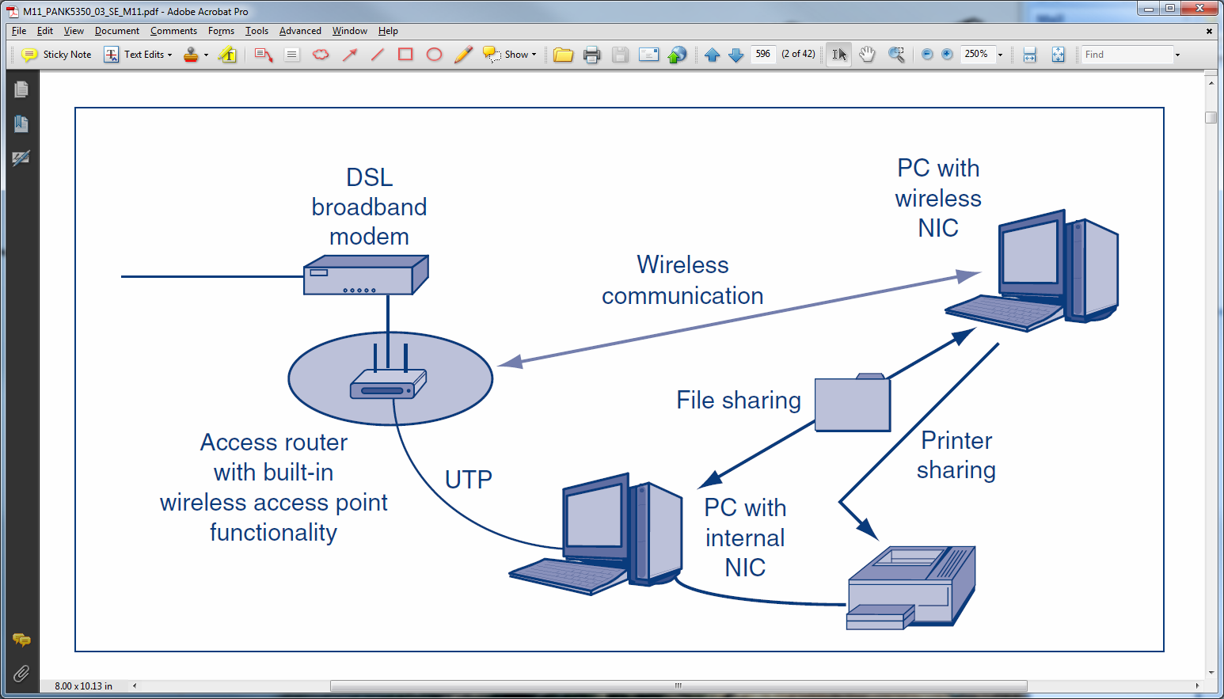
A-1: A Simple Home Network

Slide 4
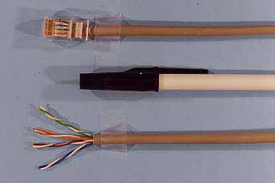
A-2: Unshielded Twisted Pair Wiring (UTP) Cord

Slide 5
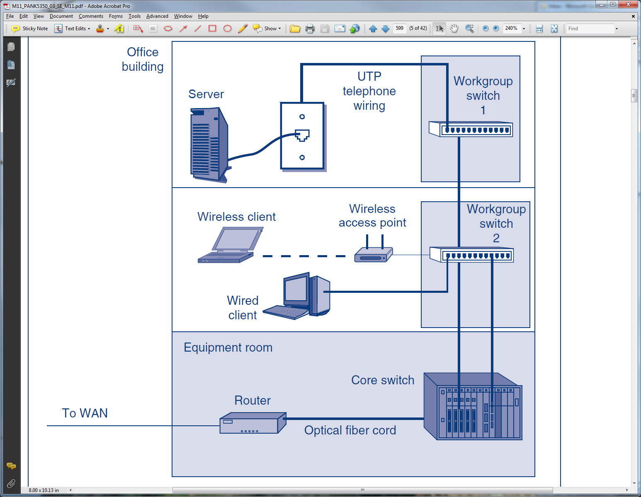
A-3: Building LAN

Slide 6
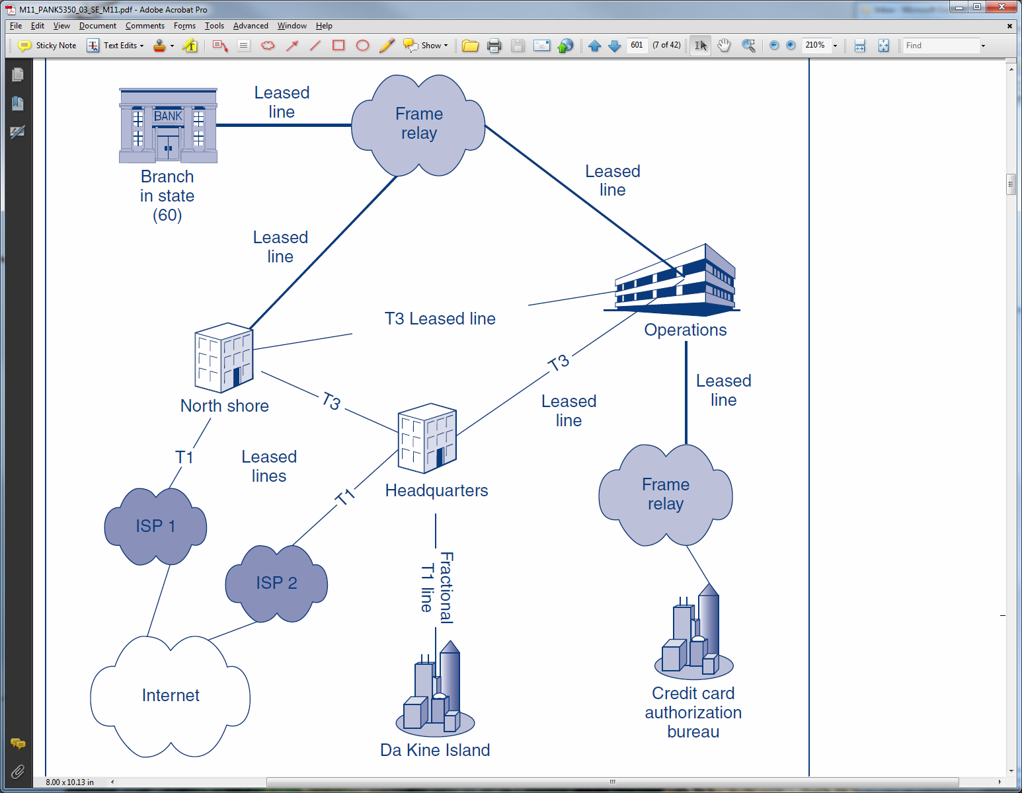
A-4: Wide Area Networks (WANs)

Slide 7
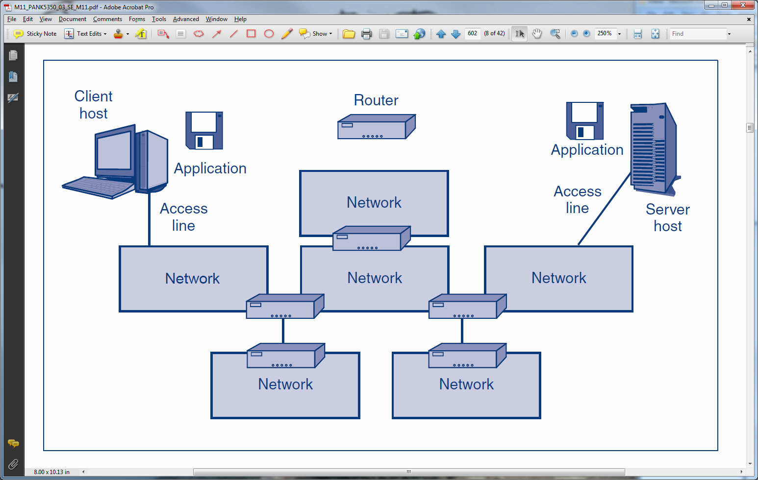
A-5: The Internet

Slide 8
A-5: The Internet
Network

Slide 9
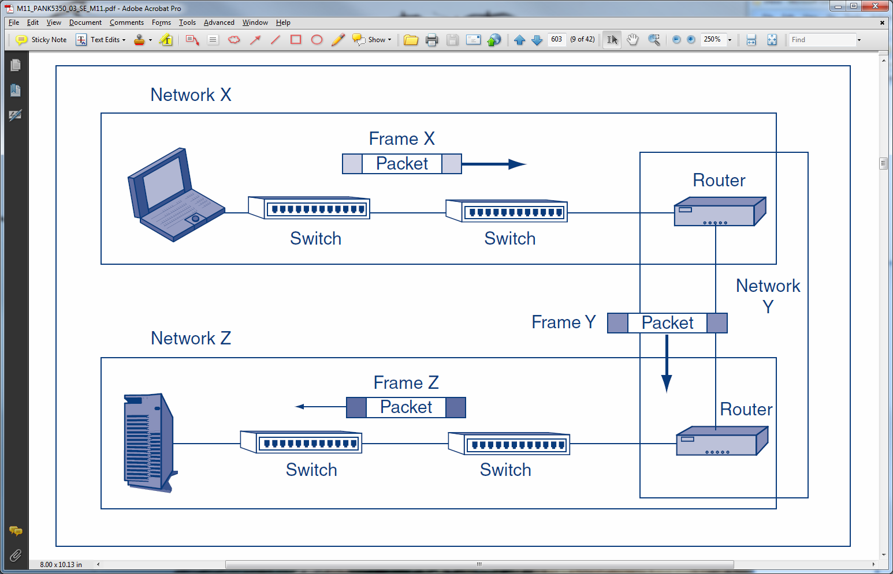
A-6: Frames and Packets
Packet travels in a different
frame in each network

Slide 10
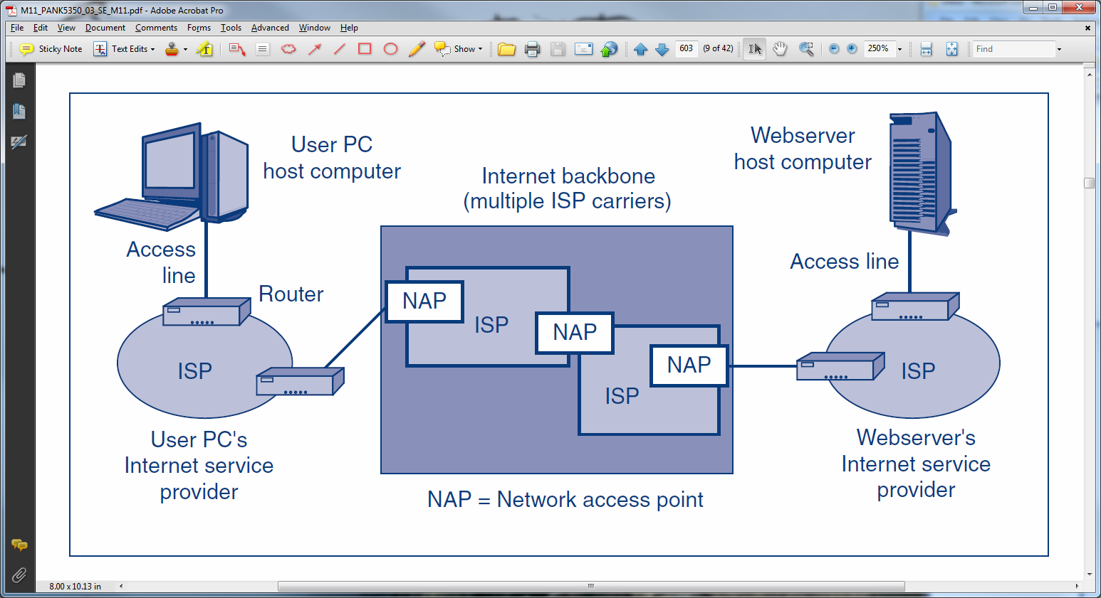
A-7: Internet Service Providers (ISPs)

Slide 11
A-8: Three Core Standards Layers
Super Layer | Description
Application | Communication between application programs on different hosts attached to different networks on an internet.
Internetworking | Transmission of packets across an internet. Packets contain application layer messages.
Network | Transmission of frames across a network. Frames contain packets.

Slide 12
A-9: Layered Standards Architectures
Super Layer | TCP/IP | OSI | Hybrid TCP/IP-OSI
Application | Application | Application | Application
 |  | Presentation
 |  | Session
Internet | Transport | Transport | Transport
 | Internet | Network | Internet
Single Network | Subnet Access | Data Link | Data Link
 |  | Physical | Physical

Slide 13
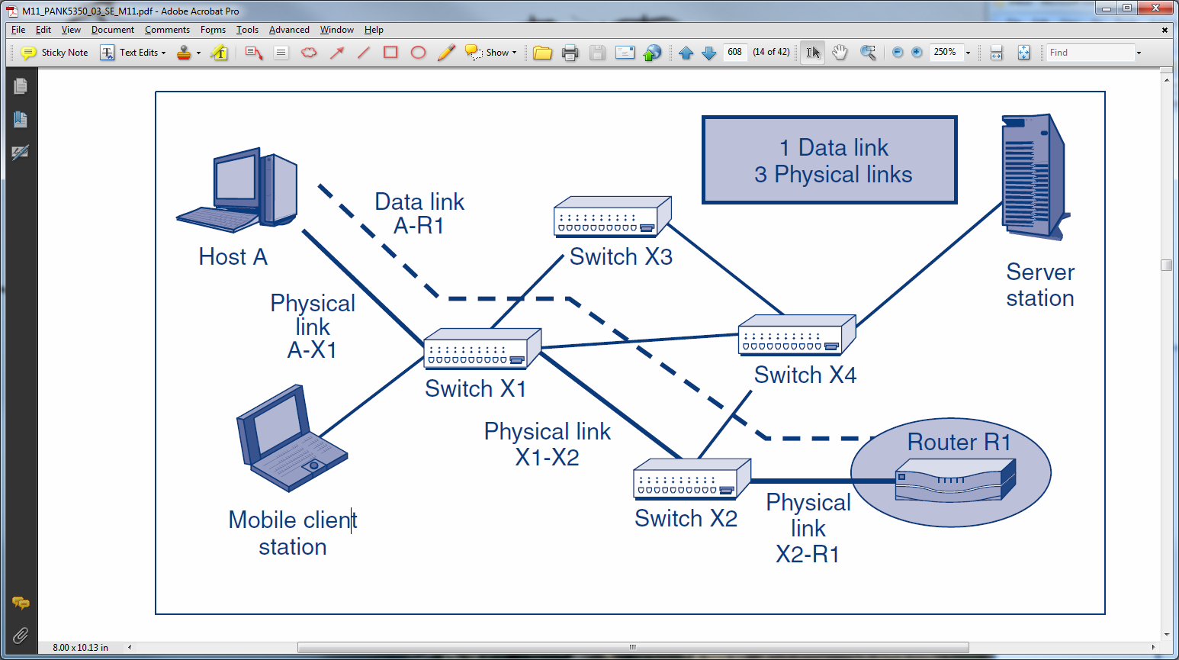
A-10: Physical and Data Link Layers
In a single network, a physical link connects adjacent devices.
A data link is the path that a frame takes across a single network.
One data link; three physical links.

Slide 14
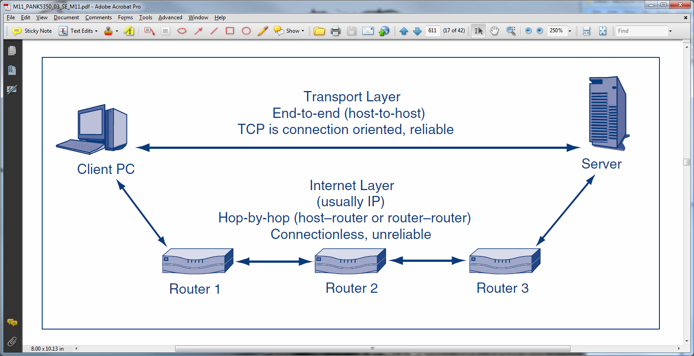
A-11: Internet and Transport Layer Standards

Slide 15
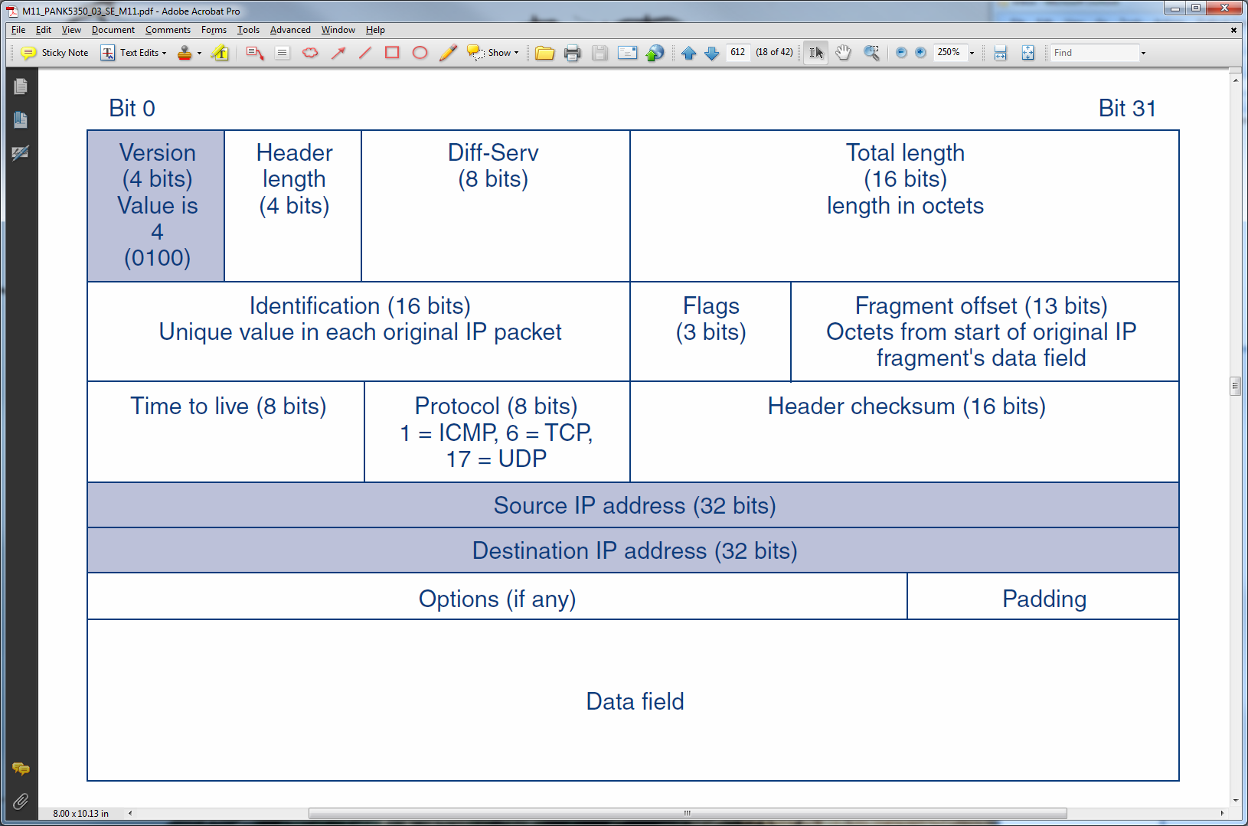
A-12: Internet Protocol (IP) Packet
IP Version 4 Packet

Slide 16
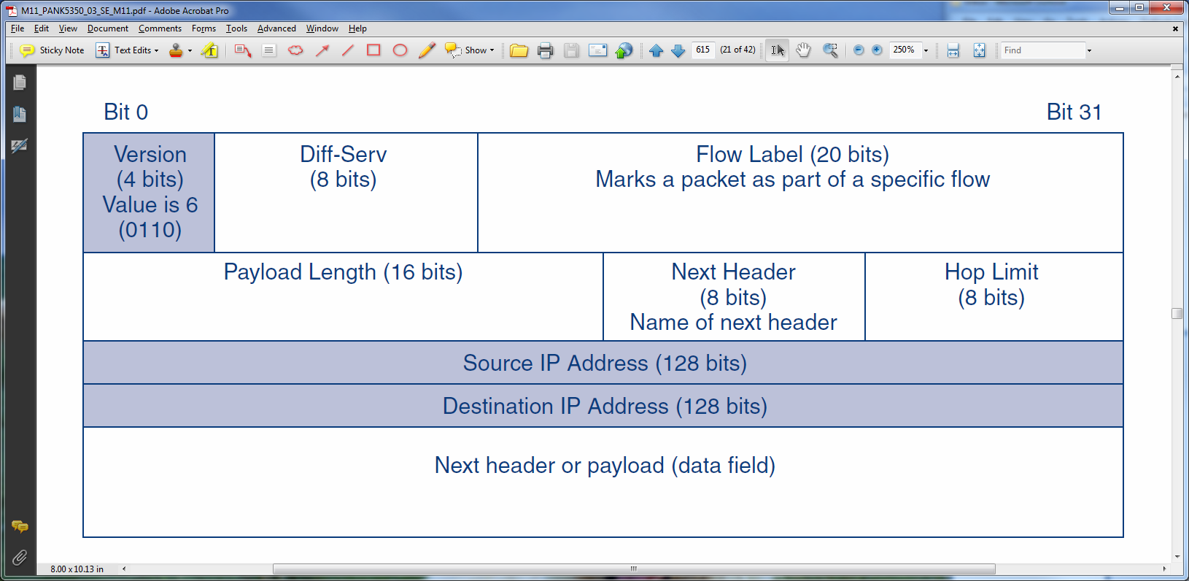
A-13: IP Version 6 (IPv6) Packet

Slide 17
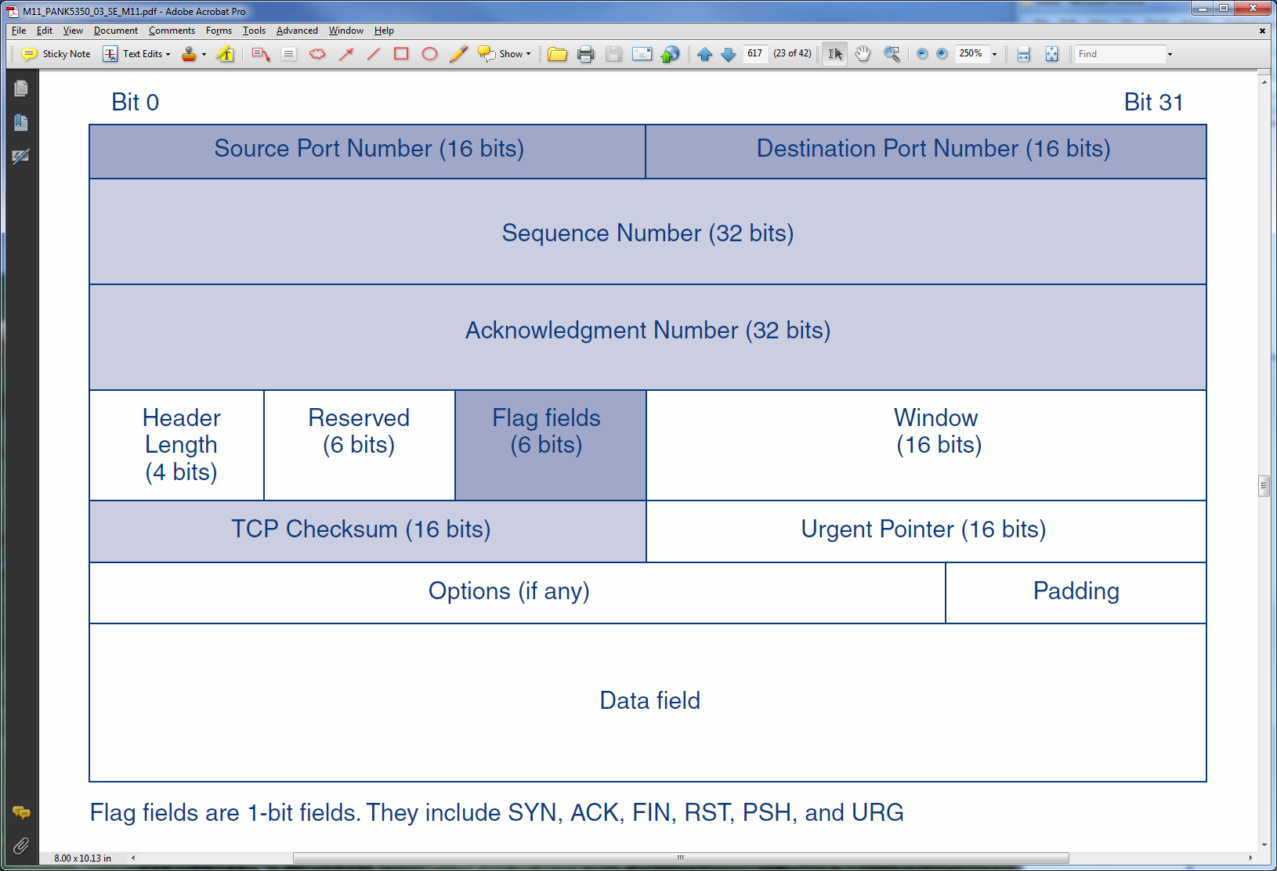
A-14: Transmission Control Protocol (TCP) Segment

Slide 18
A-15: Messages in a TCP Session
PC
transport process
Webserver
transport process
1. SYN (Open)
Open
(3)
2. SYN, ACK (1) (Acknowledgement of 1)
3. ACK (2)
3-Way Open

Slide 19
A-15: Messages in a TCP Session
PC
transport process
Webserver
transport process
1. SYN (Open)
Open
(3)
2. SYN, ACK (1) (Acknowledgement of 1)
3. ACK (2)
4. Data = HTTP Request
Carry
HTTP
Req &
Resp
(4)
5. ACK (4)
6. Data = HTTP Response
7. ACK (6)

Slide 20
A-15: Messages in a TCP Session
PC
transport process
Webserver
transport process
8. Data = HTTP Request (Error)
Carry
HTTP
Req &
Resp
(4)
9. Data = HTTP Request (No ACK so Retransmit)
10. ACK (9)
11. Data = HTTP Response
12. ACK (11)
Error Handling

Slide 21
A-15: Messages in a TCP Session
PC
transport process
Webserver
transport process
Normal Four-Way Close
13. FIN (Close)
Close
(4)
14. ACK (13)
15. FIN
16. ACK (15)
Note: An ACK may be combined with the next message if the next message
is sent quickly enough

Slide 22
A-15: Messages in a TCP Session
PC
transport process
Webserver
transport process
Abrupt Close
RST
Close
(1)
Either side can send a Reset (RST) segment at any time
Ends the Session Immediately

Slide 23
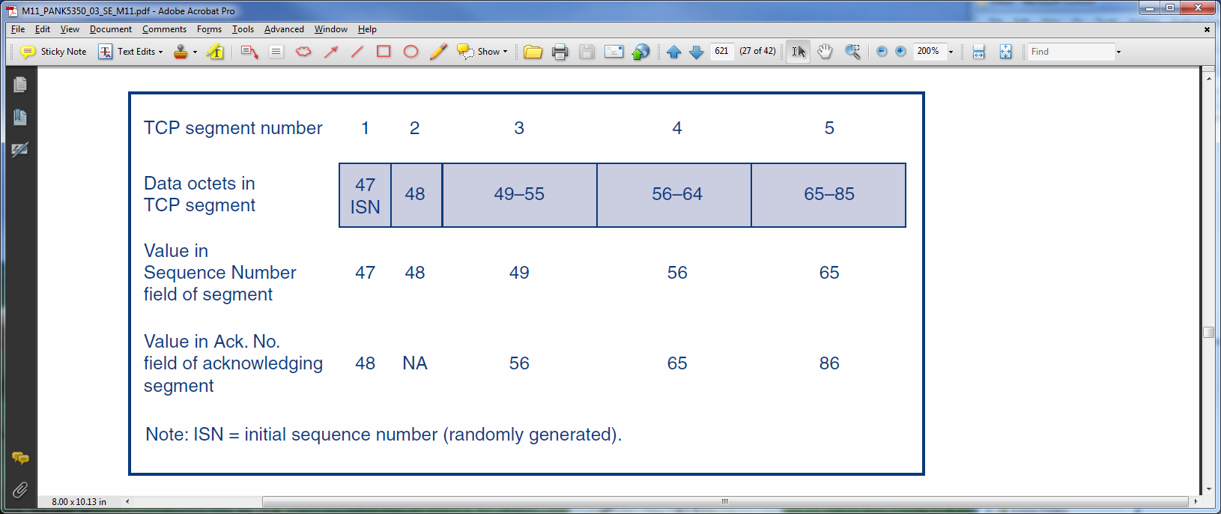
A-16: TCP Sequence and Acknowledgement Numbers

Slide 24
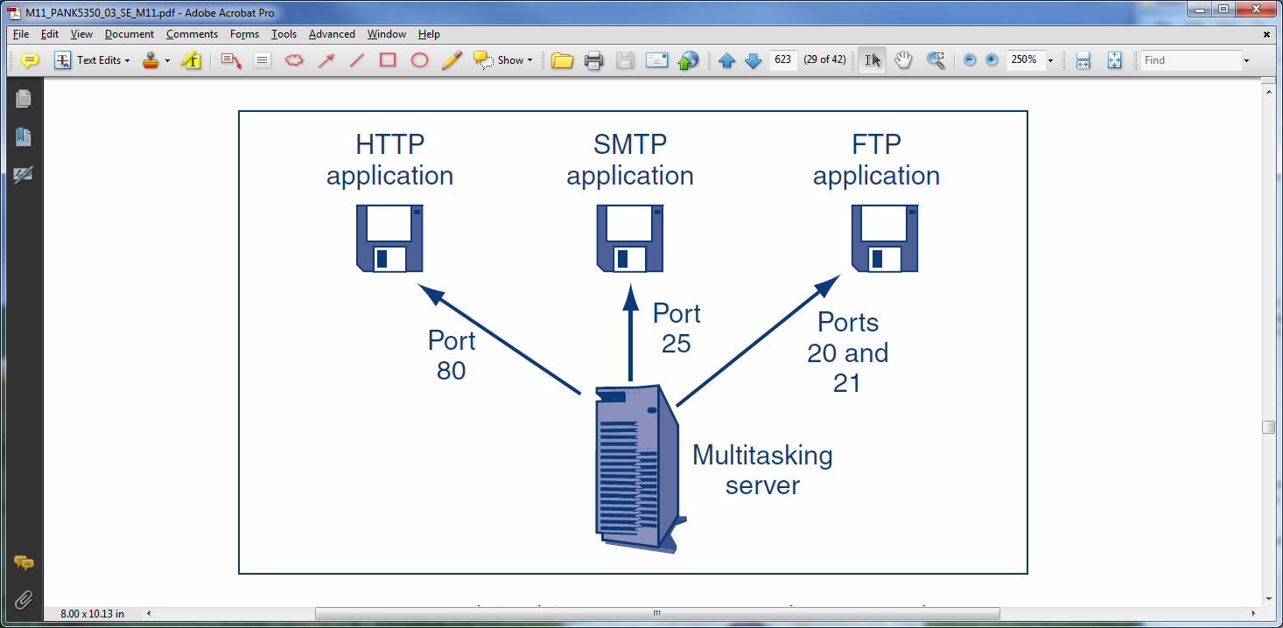
A-17: Multitasking Server Host and Port Numbers

Slide 25
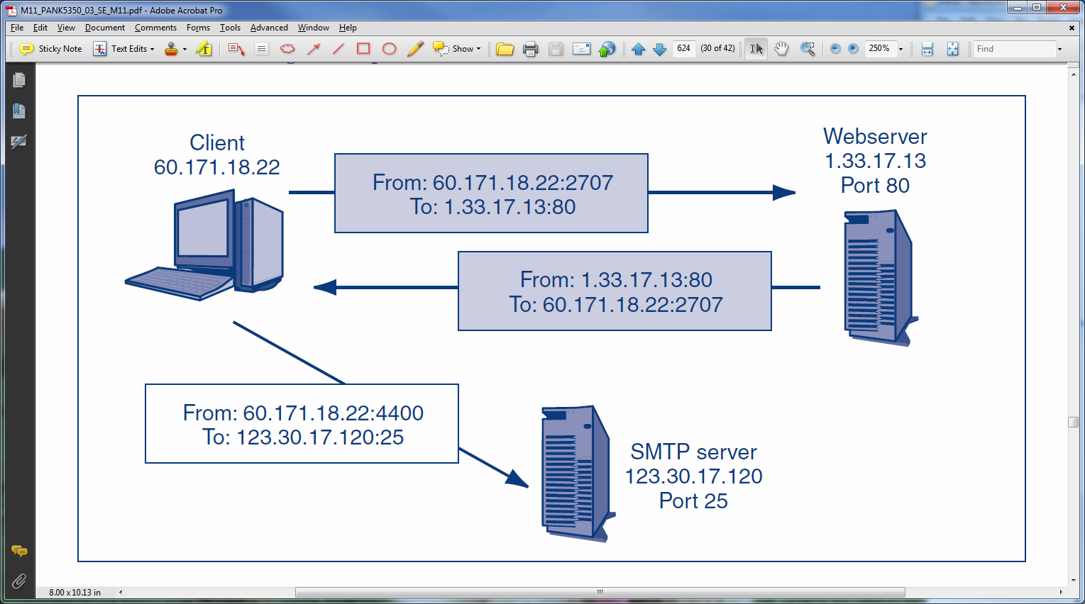
A-18: Sockets

Slide 26
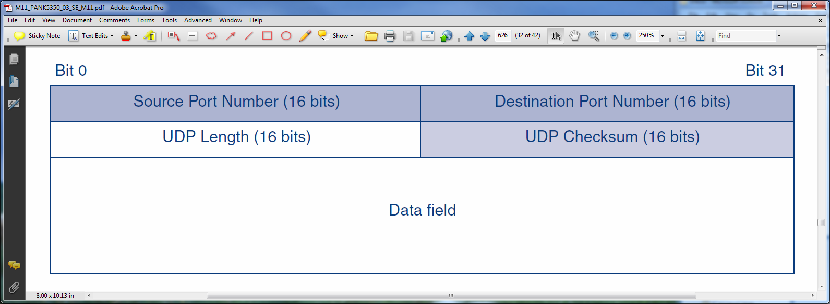
A-19: User Datagram Protocol (UDP)

Slide 27
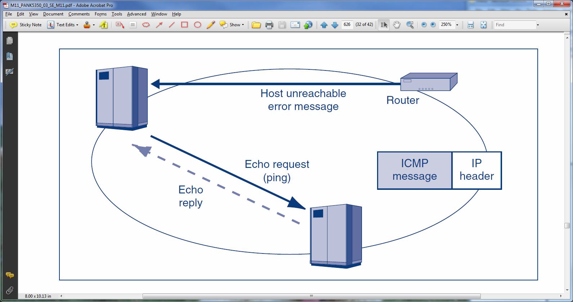
A-20: Internet Control Message Protocol (ICMP)

Slide 28
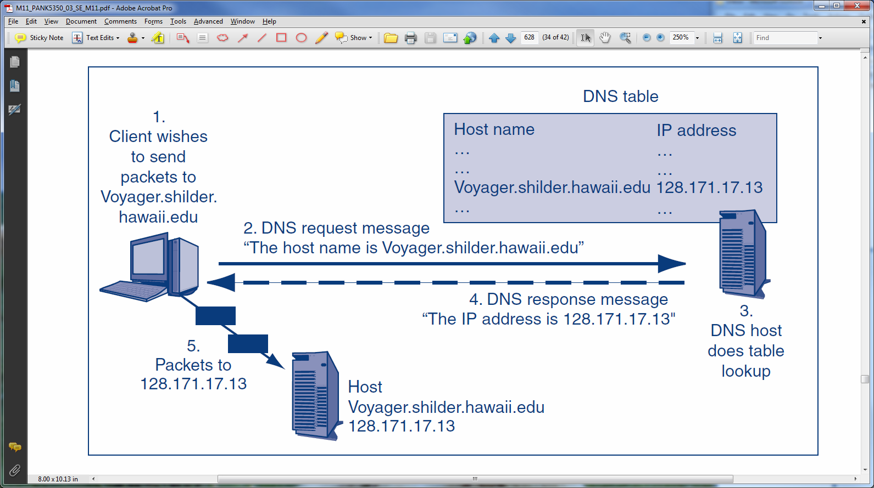
A-21: Domain Name System (DNS) Server

Slide 29
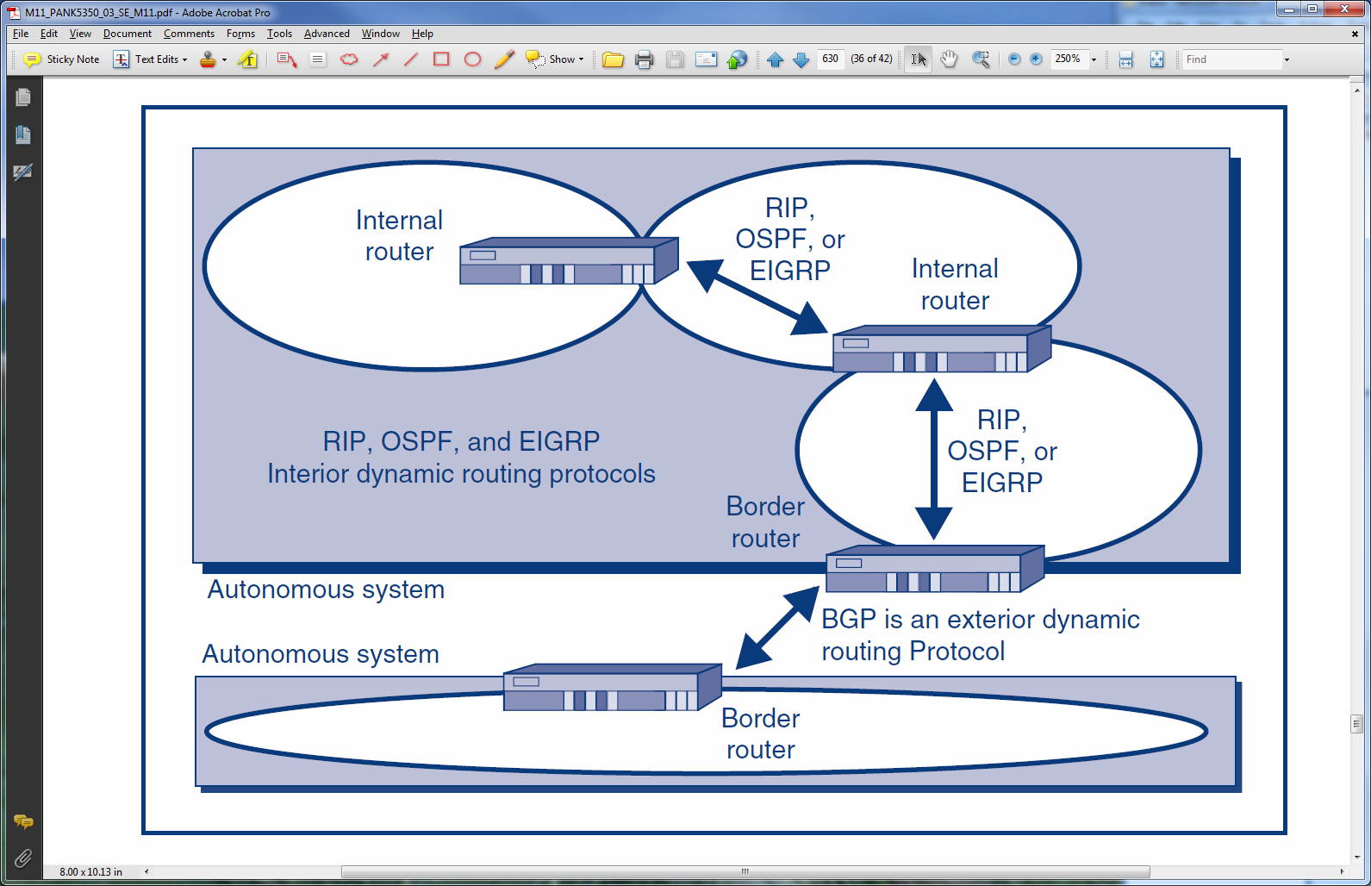
A-22: Dynamic Routing Protocols

Slide 30
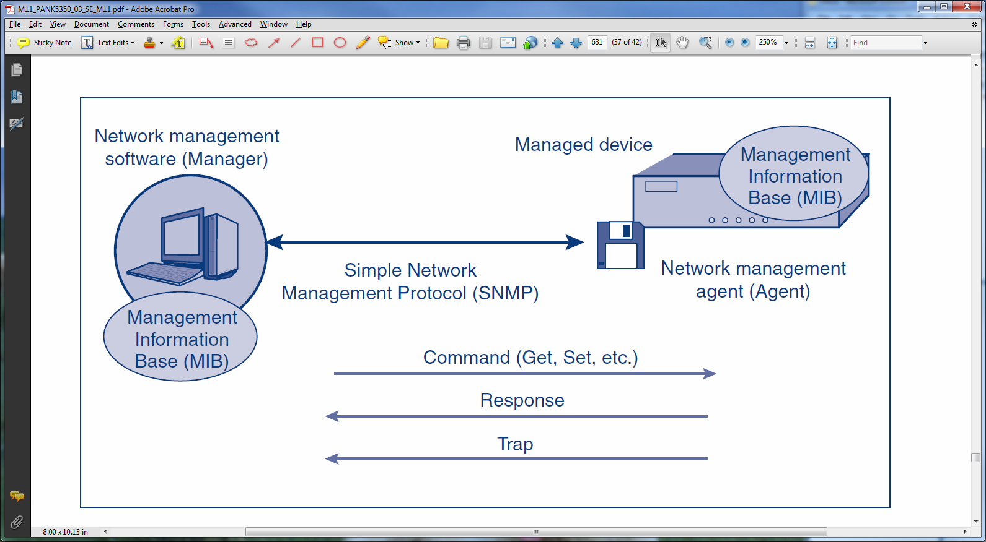
A-23: Simple Network Management Protocol (SNMP)

Slide 31
A-24: Application Standards
Application Exploits
By taking over applications, hackers gain the permissions of the exploited program
A multitude of application standards
Consequently, there is a multitude of security issues at the application level

Slide 32
A-24: Application Standards
Many Applications Need Two Types of Standards
One for the transmission of messages, one for the content of application documents
For the World Wide Web, these are HTTP and HTML, respectively
For transmission, e-mail uses SMTP, POP, and IMAP
For message content, e-mail uses RFC 2822 (all-text), HTML, and MIME

Slide 33
A-24: Application Standards
FTP and Telnet
Have no security
Passwords are transmitted in the clear, making it possible to be captured by sniffers
Secure Shell (SSH) can replace both securely

Slide 34
A-24: Application Standards
Many Other Application Standards Have Security Issues
Voice over IP (VoIP)
Service-oriented architecture (SOA); web services
Peer-to-peer applications

Slide 35
The End

Slide 36
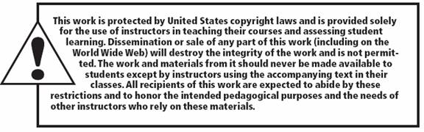
All rights reserved. No part of this publication may be reproduced, stored in a retrieval system, or transmitted, in any form or by any means, electronic, mechanical, photocopying, recording, or otherwise, without the prior written permission of the publisher. Printed in the United States of America.
Copyright © 2015 Pearson Education, Inc.

